Slide 1



Slide 2
1
POSTMAN SETUP
2
FAVORIOT RULES SETUP
3
POSTMAN LOGS

Slide 3
POSTMAN SETUP

Slide 4
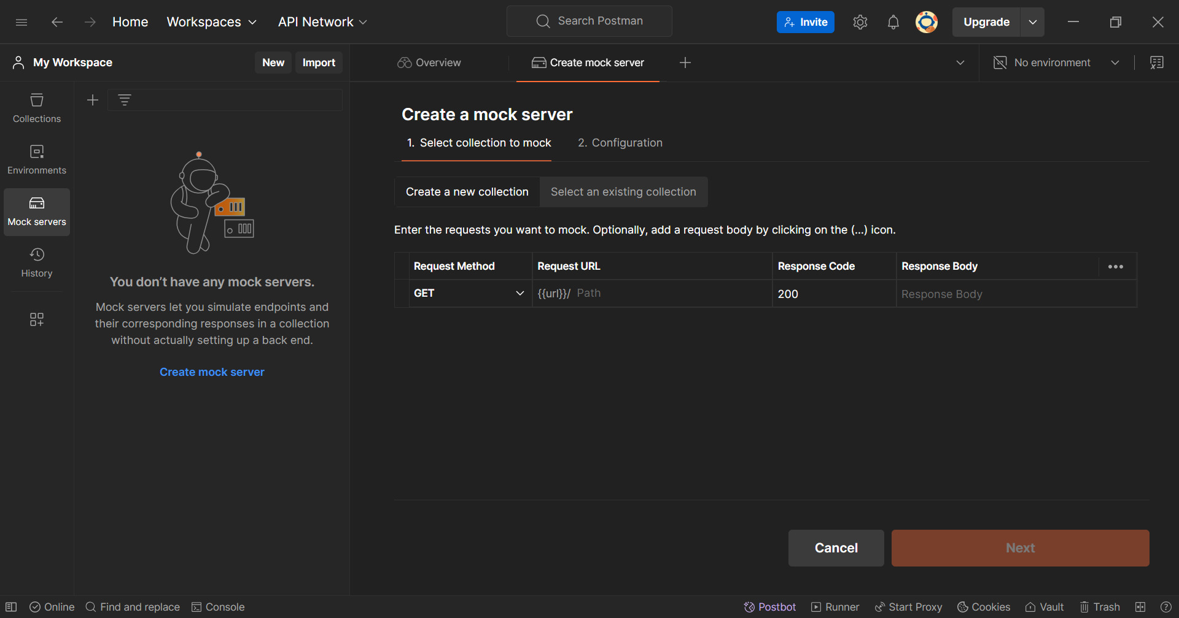
1
Open Postman. Then, click mock servers.
3
Change to POST method.
2
Create mock servers.

Slide 5
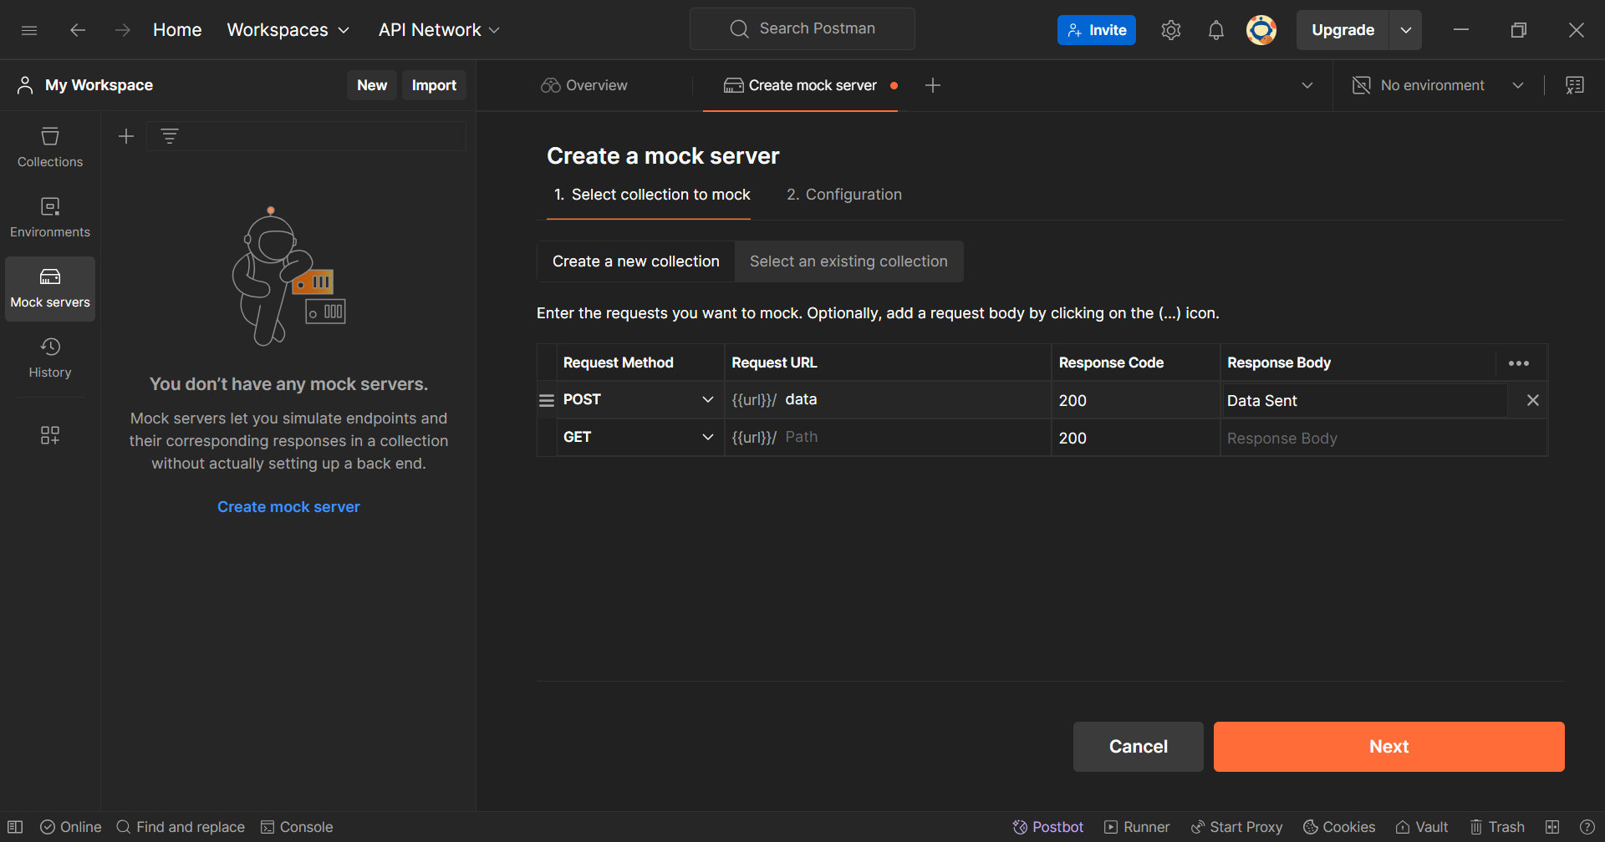
1
2
Create URL path.
Create response body.
Click next.
3

Slide 6
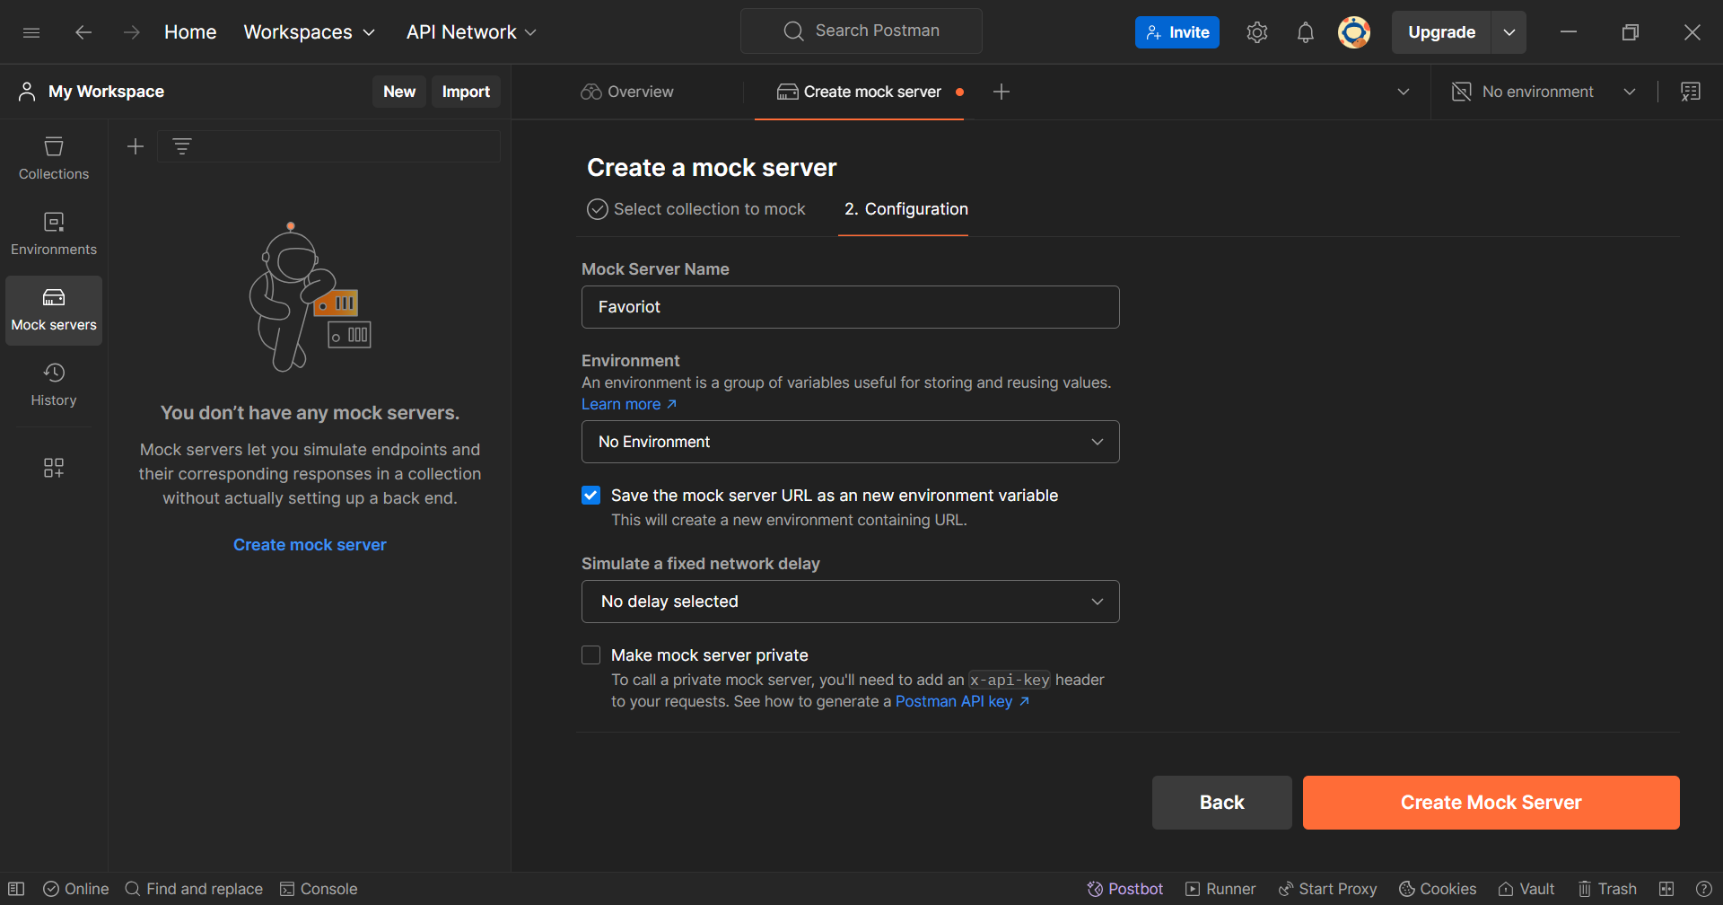
Create server name.
1
Tick the box to save URL as variable.
2
Create mock server.
3

Slide 7
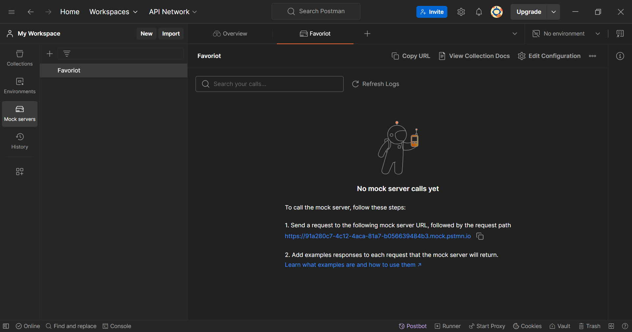
Copy the URL.
1

Slide 8
FAVORIOT RULES

Slide 9
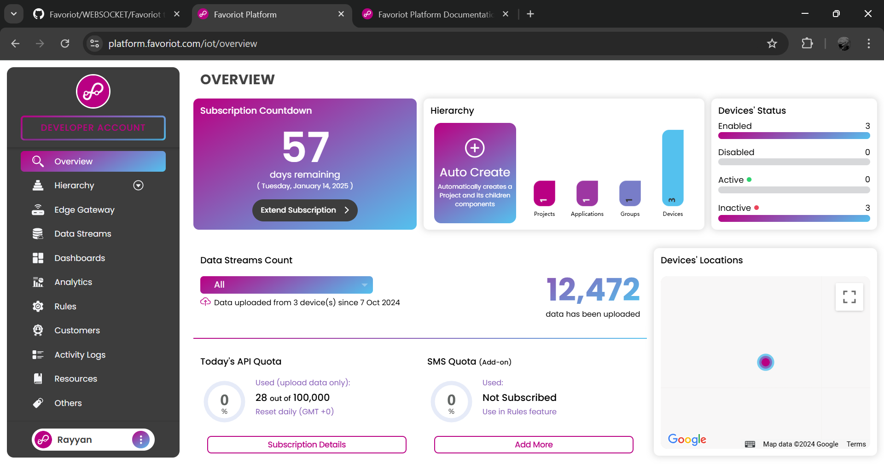
Log in to Favoriot account. Then, go to rules page.
1

Slide 10
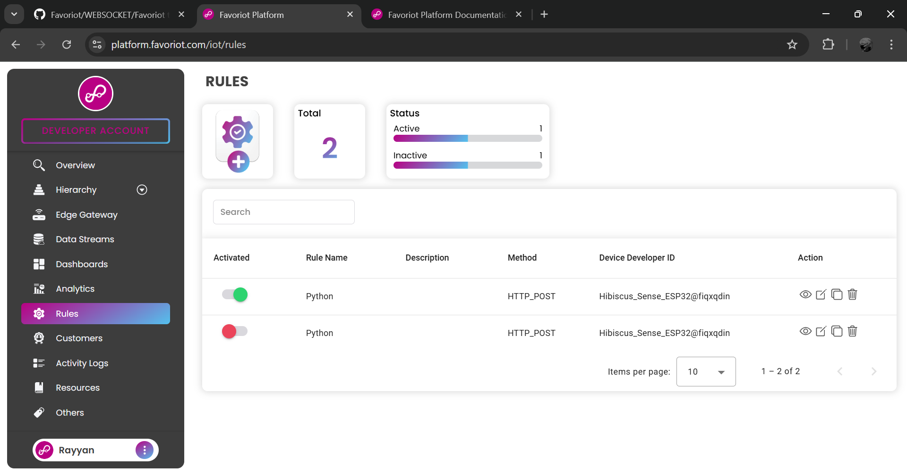
1
Create new rules.

Slide 11
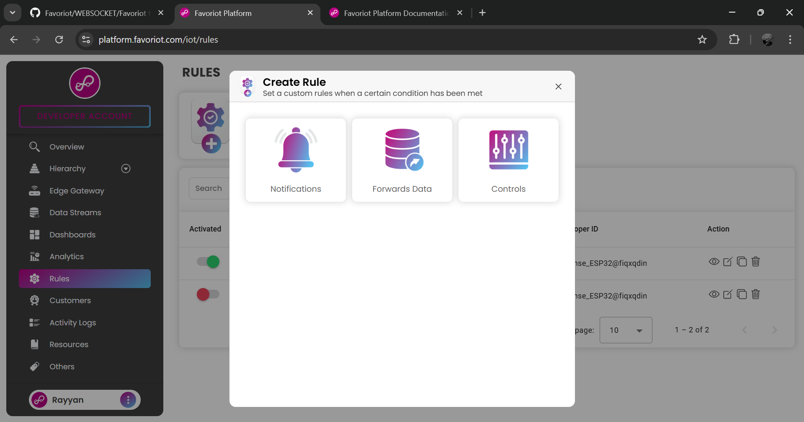
1
Click forwards data.

Slide 12
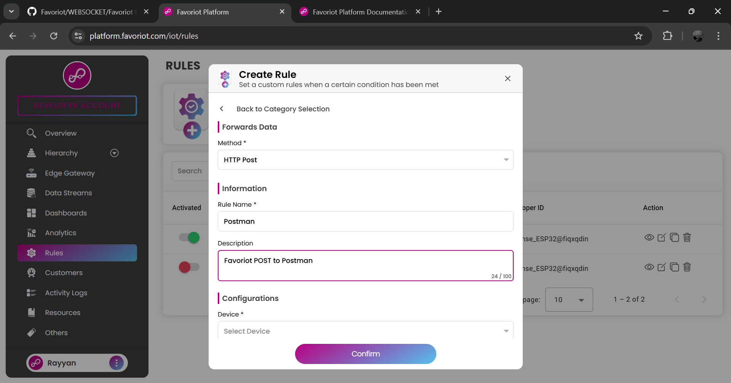
Select POST method.
1
2
Insert rule name and description.
3

Slide 13
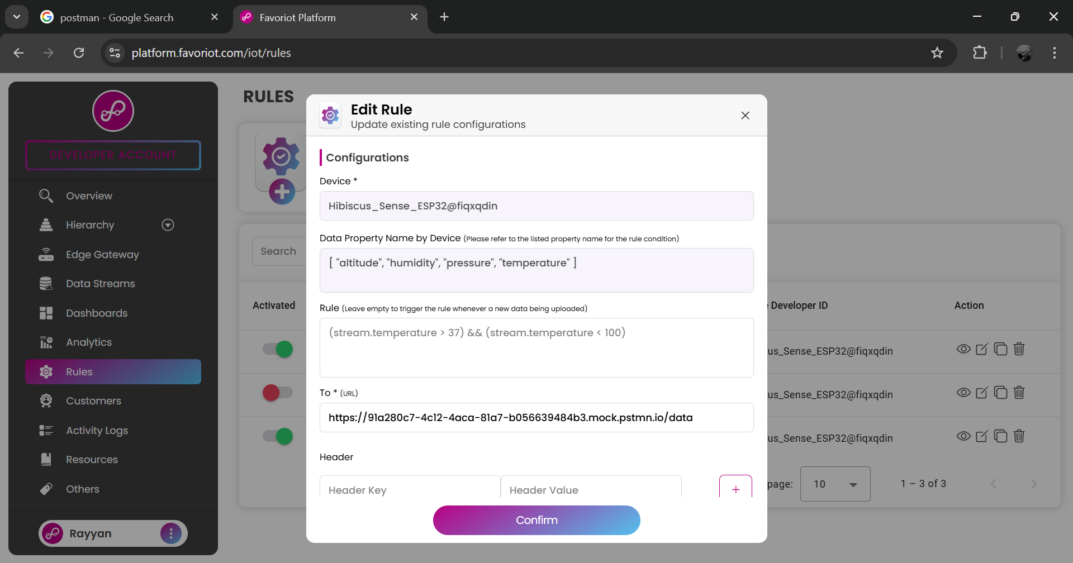
1
Select device.
2
Paste the URL that been copied from Postman and add the path that have been created.

Slide 14
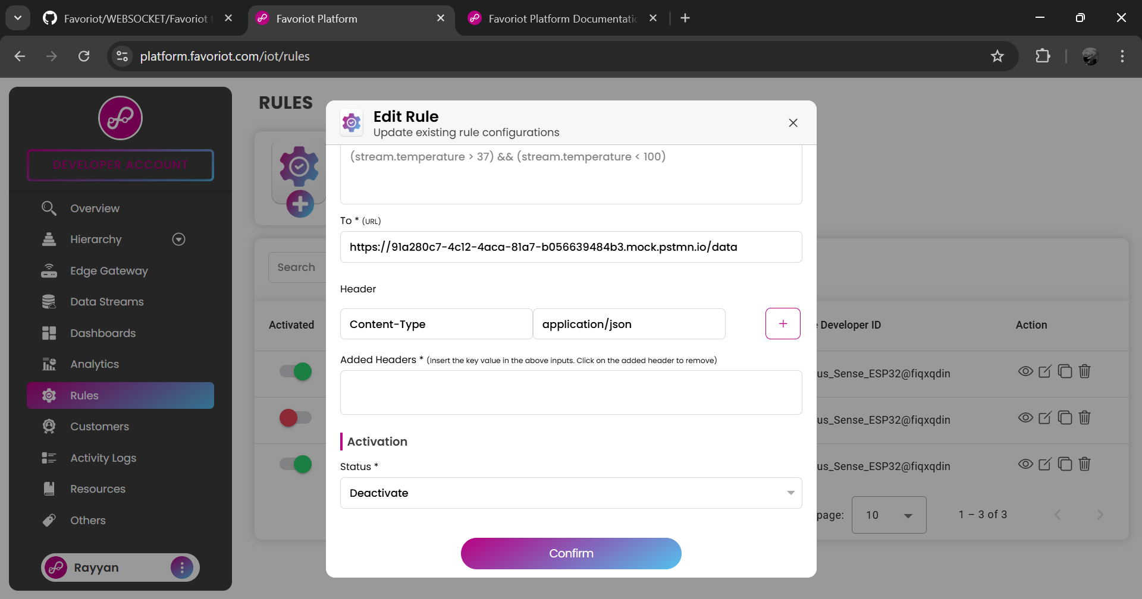
Add the headers.
1
2

Slide 15
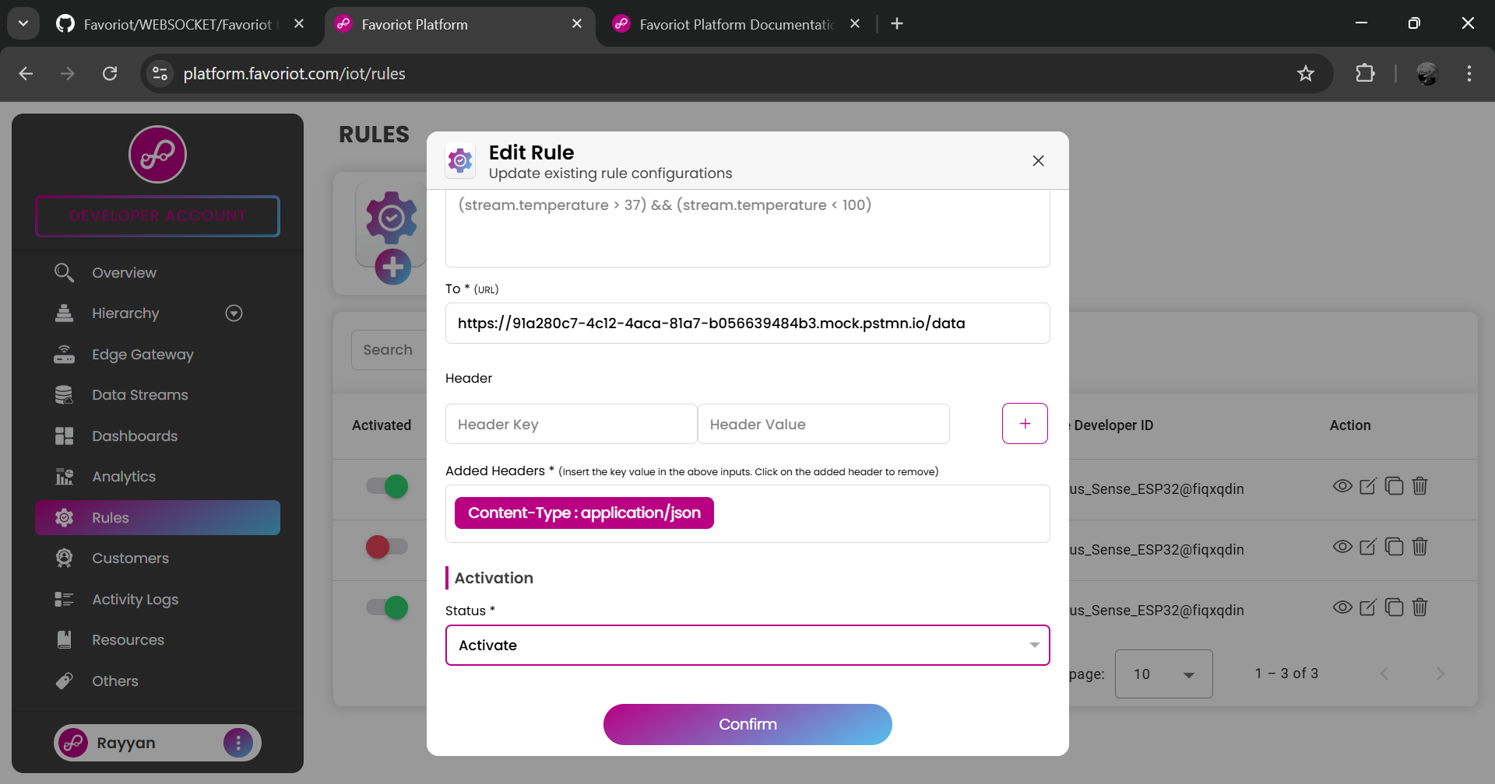
Activate the rule. Then, click confirm.
1
2

Slide 16
POSTMAN LOGS

Slide 17
1
Open Postman. Then, click refresh logs.

Slide 18
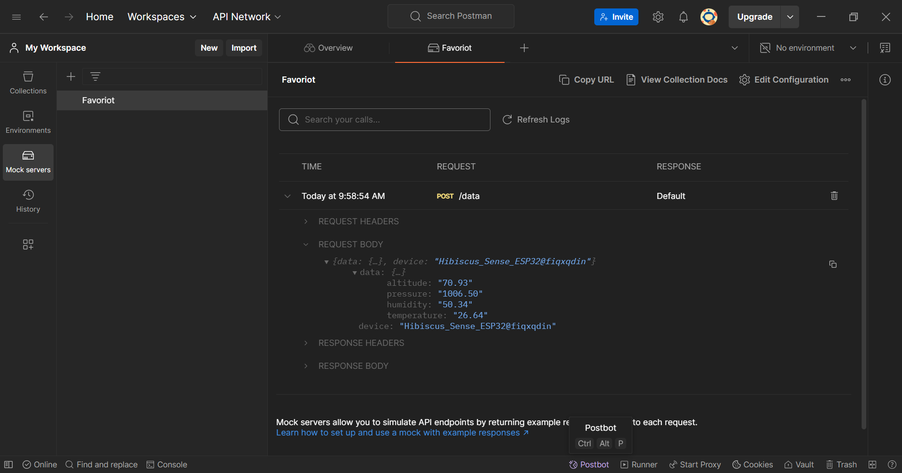
This is the data from Favoriot HTTP POST.
1

